Slide 1
Writing Across the Curriculum

Slide 2
Do Now
Take an index card from the front table and read the following quotes.
“Writing is not apart from living…” -Catherine Drinker Bower
“I am just going to write because I cannot help it.” -Charlotte Bronte
On the index card, brainstorm a list of ways you use writing in your every day life inside and outside of the workplace.

Slide 3
KWL
What do you know about writing across the curriculum?
What do you want to know about writing across the curriculum?
Think about the following when responding:
the writing process
creating writing assignments
facilitating writing in the classroom
assessing student writing

Slide 4
Overview/Objectives
Emphasize the importance of writing in all content areas
Explore the methods of writing
Discuss types of writing
Gain knowledge in creating writing assignments
Show different methods to assess writing assignments

Slide 5
Why Must We Write?
“With the proliferation of e-mail, desktop publishing, and the Internet, writing is now more important than ever. We’ve realized that we can no longer make distinctions between ‘writers and non-writers.’ Every student must be able to write- in every subject.”
Steve Peha

Slide 6
We write because . . .
output is a great way to assess student knowledge.
writing is the essential skill students need as they enter adult life.
writing helps students learn to express themselves with confidence in all subject areas and can contribute to improvements in behavior and self esteem.
students who write clearly, think clearly.
writing is power.

Slide 7
How Do We Write?
We write using the Writing Process.
The Writing Process consists of:
Brainstorming
Pre-writing
Drafting
Editing
Revising
Publishing

Slide 8
When Do We Write?
Writing can be done at any point in the lesson.
Beginning
Middle
End

Slide 9
What Do We Write?
Types of Writing:
Casual
Semi-formal
Formal

Slide 10
Casual Writing
Casual writing is comfortable writing. It is the kind of writing we as adults do every day. It is non-threatening and is very rough in terms of grammar and structure. We use it to help us remember, organize, and manage information in our daily lives. It is like talking to yourself on paper and really for your eyes only.
Examples: notes, lists, scribbles, journals, logs

Slide 11
Semi-Formal Writing
Semi-formal writing is conventional yet still comfortable. It is slightly more deliberate than casual writing, but it is nowhere near as polished as a formal piece ready to be published. It is like talking to a friend. This type of writing needs to be able to be interpretable by others, so it has to make sense.
Examples: essay questions, summaries, responses, drafts, reflections, emails

Slide 12
Formal Writing
Formal Writing is writing that is dressed up with some place to go. The audience for this type of writing is broad and possibly unknown by the author. It requires the writer to navigate through the entire writing process and uses formal language and grammar. Formal writing should be assessed in a distinct way by the instructor.
Examples: research papers, literary papers, informational reports, business letters, newspaper articles, editorials, etc.

Slide 13
Word Splash Activity Directions
Go through the words on your cards and separate them into 2 piles- words you know and words you don’t.
Discuss what you think the article you will read will be about based on the vocab.
View the title of the article.
Read the text independently and highlight/underline the vocab words.
As a group write a definition for each word based on the context clues in each sentence. Write the definition in the margin of your article next to the word and on each card.
Take the cards and organize the vocab words in sequential order as they appear in the article.
Break apart and individually write a summary of the article in your own words using the vocab in sequential order as it appears in the text.

Slide 14
Making the Writing Realistic
Writing assignments will have more value and appeal to the students if they are created taking into the consideration the types of writing that professionals would be doing in your discipline. This proves to students that writing is an integral part of the workplace for everyone.
What would a historian, biologist or computer scientist write?

Slide 15
Writing Products
In creating assignments, it is important to provide students with consistent guidelines for what should be included in their final product.
Provide students with a Product Guideline handout.
Reference all year- laminate for classroom and hand out to students
Save time in planning prompts
Use for both student and teacher assessment rubrics

Slide 16
Student Choice in Topics
There are different levels of student choice in writing. Providing some aspect of choice in an assignment inherently creates more interest and ownership for the student as well as a better final product.
Students can select a topic that appeals to them from a list of teacher generated assignments that appeal to different learning styles and are of varying abilities based on the particular classroom.
Students can create their own topics/assignments based on their own individual interests.
Ideas for student choice:
RAFTs
Tick-Tac- Toe Boards
Choice Boards

Slide 17
Uses of Choice Menus
Enrichment/Supplemental Activities
Introduce choice menu at the beginning of the unit. As the unit develops ,the students will make their choices and focus on information related to their topics.
Standard Activities
Students should have some prior knowledge of the content. The teacher would pick and choose which aspects of the content must be directly taught and which can be reinforced through the menus
Mini Lessons
Use as quick 10-15 minute lessons to introduce or reinforce concepts

Slide 18
Tic-Tac-Toe Menus
Another option for student choice in writing.
Allows student to do multiple activities to achieve a learning goal.
Differentiates instruction for students of all levels.
Provides writing assignment options for all different types of learners.
Allows students to choose from many different types of writing such as casual, semi-formal, and formal pieces.

Slide 19
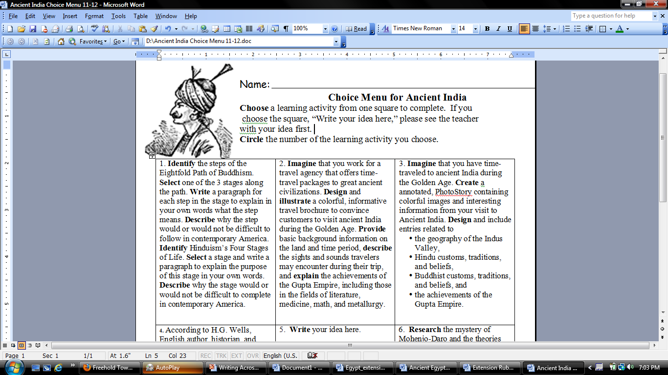

Slide 20
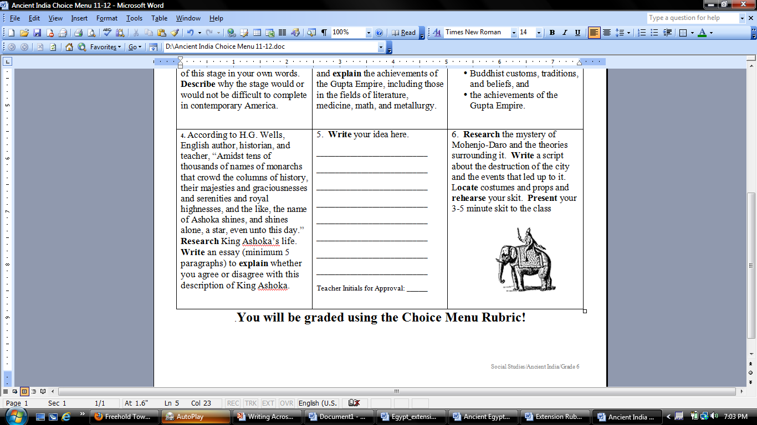

Slide 21
Modeling Writing
Use with your more semi-formal or formal assignments that will be graded more rigorously.
Provide students with an example of the kind of writing you are asking them to do. This can be done before or after you have briefly introduced the assignment.
Use a professional, student, or personal example.
Read the model independently, read it aloud to them, or do both.
Have them highlight elements or aspects of the writing you are working on as you discuss the piece and its merits.
Have them refer back to the example as they work on their assignments for style and structure, so they may model the example.

Slide 22
Creating Writing Assignments/RAFTs
Determine what the purpose is for writing.
Think about what concept(s) you want students to demonstrate understanding and/or mastery of.
Create a prompt that clearly identifies the following things for the piece of writing:
Role
Audience
Format
Topic
The RAFT should indicate without explicitly stating what type of writing- casual, semi-formal, formal- a student will be doing.

Slide 23
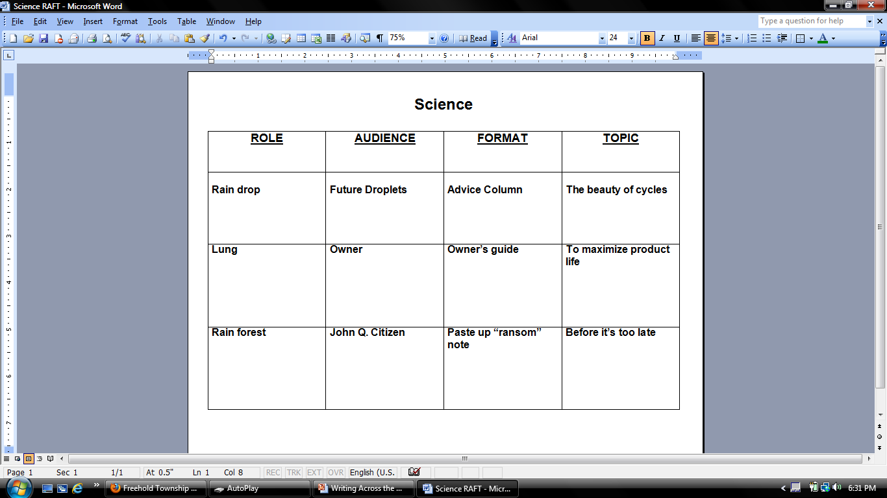

Slide 24
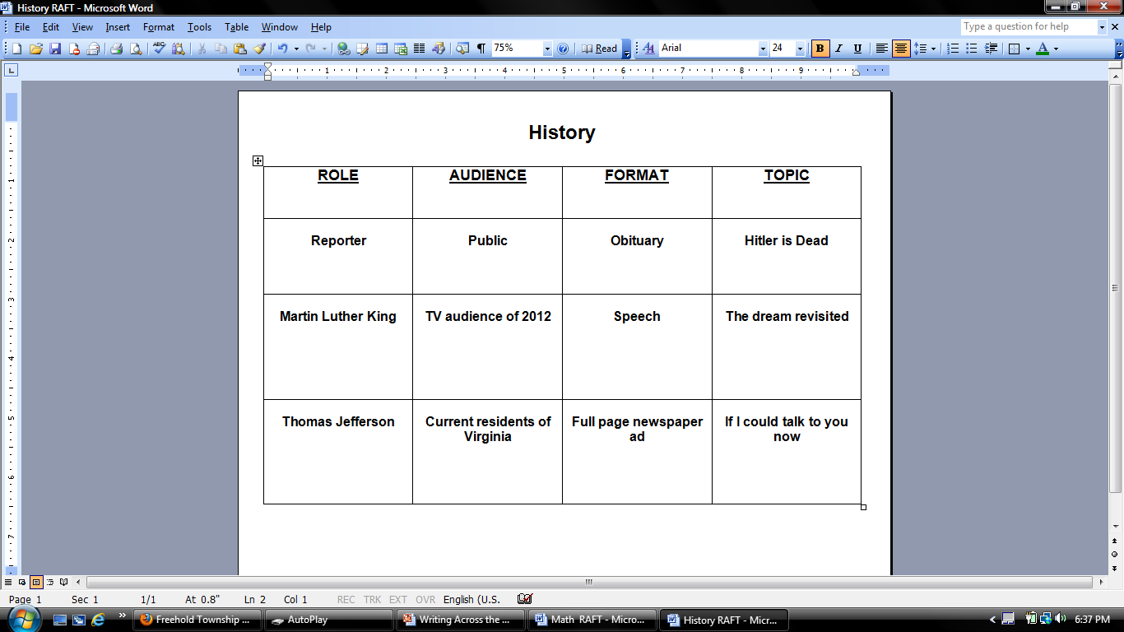

Slide 25
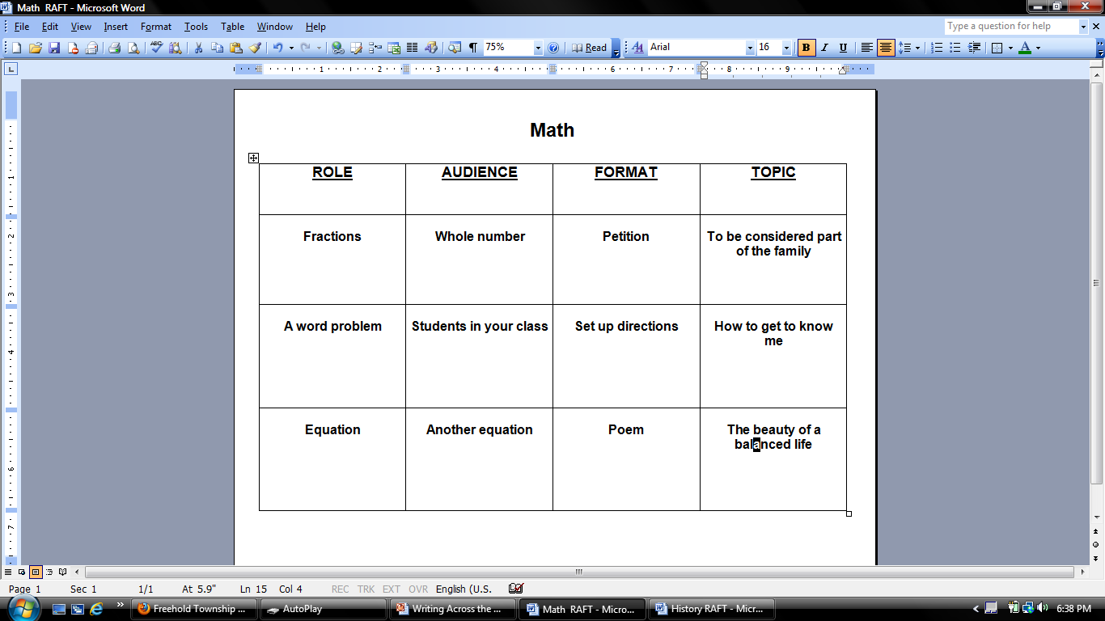

Slide 26
Microthemes
A microtheme is term created by John Beam in his article “Microtheme Strategies for Developing Cognitive Skills.”
A microtheme is:
a surprisingly brief essay that is limited to one side of an index card.
a clever way to increase learning through writing.
a style of writing that forces the writer to use clear, concise language as well as varied sentence structure.
an efficient way for instructors to determine student knowledge.
An easily graded assignment because of its brevity.
Microthemes can be categorized in many ways: summary writing, thesis support, data-provided, and quandary-posing

Slide 27
Example Microtheme Prompts
What was _________ purpose in ____________?
Find an example of ___________ and demonstrate __________.
Compare and contrast________________and _______________.
What was ____________most important achievement and why?
Find evidence to support ________________ in _______________.
Explain what you find most interesting about________________.
What were the causes of _________________________.
Explain the process of__________________________.

Slide 28
Ideas for Writing
Advertisements
Affidavits
Announcements
Biographical sketches
Blurbs
Board game instructions
Brochures
Bumper stickers
Captions
Case studies
Children’s books
Commentaries
Debate outline/notes
Declarations
Definitions
Dialogues
Directions
Editorials
Emails
Encyclopedia entries
Epitaphs
Eulogies
Expense accounts and defense
Fact sheets
Graffiti
Greeting card
Historical accounts
Fairy tales, myths, novels, plays
Poems
Indexes
Instructions
Interviews
Itineraries
Job descriptions/specifications
Journal entries
Lab reports
Last Will and testaments
Legal briefs
Legislation
Lesson plans
Letters: advice, application, resignation, complaint, congratulation, persuasive, editorials
Logos
Lists
Math stories
Memos
Menus
Messages
Minutes of a meeting
Monologue
Mottos/slogans
New stories- paper, radio, tv
Orations
Parodies
Proposals
Requests
Reviews
Screenplays
Sermons
Skits
Speeches
Test questions
Wanted posters
Word puzzles

Slide 29
Writing Traditional Prompts
Writing clear, concise, but comprehensive prompts for an assignment that encompasses all of the expectations for writing is an art in itself and takes practice.
When assigning a formal piece of writing:
- try to always have a prompt for your students .
- include any additional directions for writing that further detail your expectations and what needs to be included in the piece.
Include in the prompt:
Page length of writing to be done.
Specific words (analyze, discuss, interpret, compare, contrast, etc.) that tell your writer what level of thinking you expect the writing to demonstrate.
Leading questions that might help the writer with the thought process or organization of the writing.

Slide 30
Example Writing Prompt
The newspaper USA Today published an article on the subject of the make-up of the American family. A recent survey found that the traditional idea of a family as a married mother, father, and two children is no longer what the average American family looks like. “Families are more diverse and the structure of them is more in flux,” says sociologist Kelly Musick. The way people define a family has also changed.
What do you think? What does it mean to be a family? Who can be part of a family? How is it formed? Please write an essay that explores your definition of a “family.”
The essay should be approximately two typed full pages. It should have an introduction, body, and conclusion. Ideas should be supported with your observations, experiences, and examples. Finally, take time to proofread the essay for grammar mistakes before turning it in.

Slide 31
Assessing Writing Assignments
Assessment can be done in many different ways for all levels of writing. Assessment does not always have to be done by the teacher!
For casual writing, it can be as simple as using the Think, Pair, Share…Square.
For semi-formal writing, it can consist of students reading each other's pieces and responding back to one another with some purpose in mind.
For formal writing, there should be a rubric that effectively shows the students the reasoning for the grade.

Slide 32
Effectiveness of Rubrics
Rubrics are simplified grading charts.
Rubrics do the following:
outline the overall expectations for an assignment.
highlight the criteria that the students must meet.
identify the points or grades a student can earn for each part of the assignment.
take a little extra time to prepare, but save time when grading.
create more objectivity when assigning a grade
increase student understanding of expectations when given at the beginning of the assignment.
produce better final pieces.

Slide 33
Student Centered Assessment
Assessment Tools
Query
Mirror, Mirror
Reflective Questions
Please Help

Slide 34
Creating a Rubric
Make a list of what the goals for learning are for the assignment.
Organize them in order from most important to least important.
Determine if there are subcategories for each component or things you will be looking for in the piece.
Decide what each category is worth out of 100 points
Create a chart that simplifies your grading process by listing and categorizing those elements. Allow for some sort of space for your comments in each area and/or space for an overall comment and final grade.
Distribute and display this rubric during the time your class is working on the assignment. You can post it on your website and even have parents sign off that they have seen it.
Hand back with the assignment, so that students can analyze their own success in completing the piece.

Slide 35
Tips to Cut Grading Time
Use peer evaluation using rubrics
Use portfolios
Use journals
Grade only a portion of the assignment
Grade only one or two elements of an assignment
Stop grading if an assignment has too many errors. Put a line where you ceased to read.

Slide 36
Portfolios
Portfolios serve as a comprehensive way for teachers to assess student learning through writing.
Are more than a folder to store work.
Serve as a way for students to set goals for improving their individual writing process and reflect upon their learning and progress in writing.
Provide students with choice by the opportunity to select pieces from their portfolios to be revised and graded.

Slide 37
Portfolio Reflection
It is important for students to reflect on why they selected a certain piece of writing for a portfolio. This can be done in letter form as to make it informal and more personal.
Guide this reflection as you would a normal assignment. Give students a prompt of things to consider when writing their reflective piece.
Consider asking questions like the following:
Why did you select this particular piece to be graded?
What did you like most about the assignment?
What did you like least about the assignment?
What were your original goals for learning? Did you reach these goals and to what extent? What grade would you assign yourself for this piece? Explain your reasoning.
What part of the writing process for this assignment was most helpful to you?
What kinds of writing assignments would you like to see more of in the future?
How can I help you become a better writer for this class?

Slide 38
The Power of Pen to Paper
“Writing, like life itself, is a voyage of discovery.” -Henry Miller
“Writing is not a pre-planned recitation of what you know; writing is thinking.” -Donald Murray
“Writing and rewriting is a constant search for what one is trying to say.”
John Updike
“The two most engaging powers of an author are to make new things familiar and familiar things new.” -Dr. Samuel Johnson

Slide 39
Today and Tomorrow……
What did you learn from the workshop about writing across the curriculum that you feel you could easily implement in your content area?
In a follow up workshop on writing, what would you like to learn more about?

